Slide 1
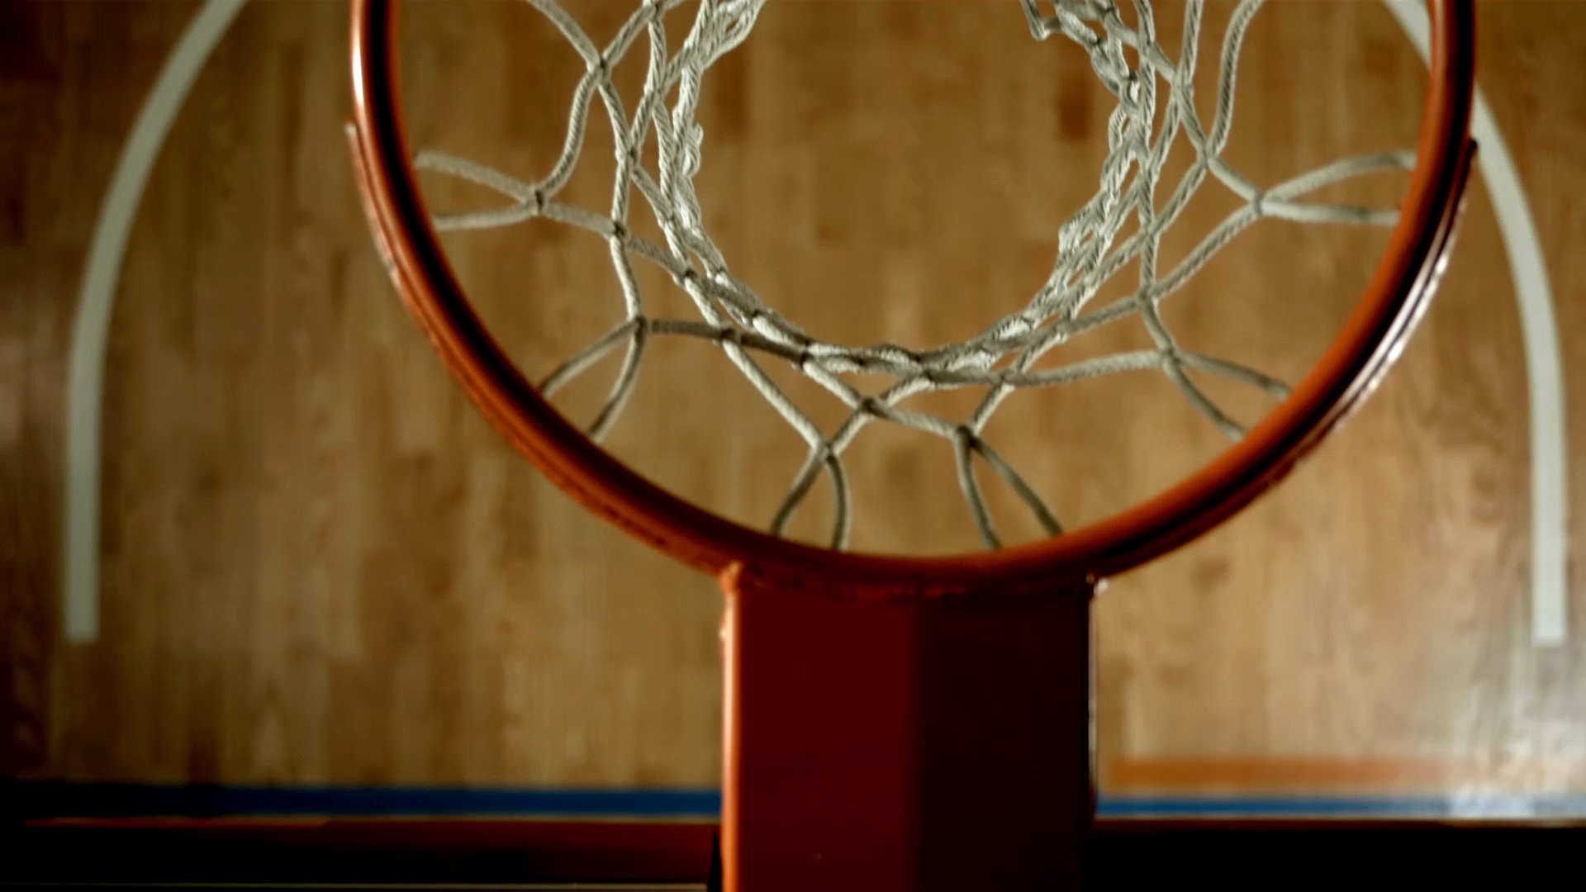
NBA Legend Analysis
Brett Sutow
DSC 680

Slide 2
Overview
The goal of this study is to understand the modern-day NBA Legends
Who should be considered the greatest player in the modern era
Where do these player's peak
How should we value them
This study will provide us with a better understanding of these legendary players

Slide 3
The Eye-Test
For years players skills were determined by ”the eye-test”
Analytics and data are now widely accepted for judging players
Data science is now a growing tool in the sports field

Slide 4
Players
Shaquille O’Neal
Kobe Bryant
Michael Jordan
Karl Malone
Dirk Nowitizki
LeBron James

Slide 5
Statistics
Offense:
Points Per Game
Offensive Rebounds
Field Goals
Free-Throw Percentage
Defense:
Blocks
Steals
Defensive Rebounds

Slide 6
Analysis
Observe the statistics and a key data points
Create visualizations to understand player progression
Build comparisons between players
Determine value of each NBA Legend

Slide 7
Offensive Analysis
The following will show an analysis on offense for these NBA Legends

Slide 8
PPG Average
Shaq O’Neal Career Average Points: 25.13636363636363
LeBron James Career Average Points: 26.933333333333334
Kobe Bryant Career Average Points: 24.200000000000006
Dirk Nowitzki Career Average Points: 20.109523809523814
Michael Jordan Career Average Points: 29.45333333333333
Karl Malone Career Average Points: 24.689473684210526

Slide 9
NBA PPG Comparison
Jordan was the highest scorer on average
Dirk Nowitzki was the worst

Slide 10
ORB Average
Shaq O’Neal Career Average Offensive Rebounds: 3.6454545454545455
LeBron James Career Average Offensive Rebounds: 1.161111111111111
Kobe Bryant Career Average Offensive Rebounds: 1.0650000000000002
Dirk Nowitzki Career Average Offensive Rebounds: 0.9333333333333332
Michael Jordan Career Average Offensive Rebounds: 1.5133333333333332
Karl Malone Career Average Offensive Rebounds: 2.389473684210526

Slide 11
NBA ORB Comparison
Shaquille O’Neal was a clear favorite and leader in this category
Karl Malone was the closest competitor

Slide 12
FT Percentage Average
Shaq ONeal Career Average Free Throw Percentage Made: 0.5339090909090909
LeBron James Career Average Free Throw Percentage Made: 0.7296666666666666
Kobe Bryant Career Average Free Throw Percentage Made: 0.8349499999999999
Dirk Nowitzki Career Average Free Throw Percentage Made: 0.8707142857142858
Michael Jordan Career Average Free Throw Percentage Made: 0.8309333333333334
Karl Malone Career Average Free Throw Percentage Made: 0.7344736842105263

Slide 13
NBA FT Percentage Comparison
This is the only category Dirk Nowitzki was a leader in
Shaquille O’Neal was statistically bad at FT’s

Slide 14
FG Made Average
Shaq O’Neal Career Average Field Goals Made: 10.018181818181818
LeBron James Career Average Field Goals Made: 9.838888888888887
Kobe Bryant Career Average Field Goals Made: 8.45
Dirk Nowitzki Career Average Field Goals Made: 7.133333333333333
Michael Jordan Career Average Field Goals Made: 11.093333333333332
Karl Malone Career Average Field Goals Made: 9.010526315789475

Slide 15
NBA FG Comparison
Jordan was the best field goal maker
Dirk Nowitzki was the worst

Slide 16
Defensive Analysis
The following will show an analysis on defense for these NBA Legends

Slide 17
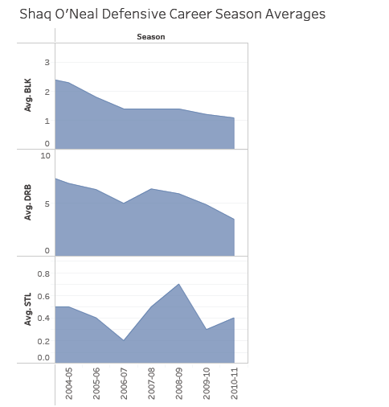
Defensive Comparison
Shaquille O’Neal was the most dominating defensive force
Michael Jordan only beat Shaq in the category of steals

Slide 18
Results
Michael Jordan is the statistically the best player in the modern era
Shaquille O’Neal should be considered the second best
The worst of these NBA legends would be Dirk Nowitzki
Important note: LeBron James’ is still active

Slide 19
NBA Legend Peak Ages
This allows us to value players based off performance
Better judge superstar players contract lengths
Pay them the most during their peak years

Slide 20
Michael Jordan

Slide 21
LeBron James

Slide 22
Shaquille O’Neal

Slide 23
Dirk Nowitzki

Slide 24
Karl Malone

Slide 25
Kobe Bryant

Slide 26
What is the Peak Age?
Kobe Bryant, Shaquille O’Neal, Karl Malone, Dirk Nowitzki; each had their best or career peaks between the ages of 26 and 28
LeBron James peaked statistically around 21 to 22
Michael Jordan peaked around 22 to 23

Slide 27
Outcome
Help provide backing to greatest NBA player question
Provide a better understanding of player's peak age
Build more in-depth knowledge regarding player comparison

Slide 28
Questions
These questions were pre-determined from a panel:
Where do these players fall with other NBA players?
How statistically impactful is it that Michael Jordan retired several times?
Does a players career actually get impacted for playing longer?
How does one handle players who dominate for a period of time, but statistically fall off at the end of their career?
Could LeBron James surpass the other players if he continues to play?
Should LeBron have been left off of this list of players considering he is still playing?
Does a player's position impact longevity of a career?
Should a player's position be considered when determining overall performance?
Why should prior to the modern era basketball players be ignored?
Could we feasibly create a value to each statistic?

Slide 29
References:
Basketball Statistics and History. (n.d.). Basketball-Reference.Com. Retrieved June 27, 2021, from https://www.basketball-reference.com/
Cohen, L. (2020, February 20). How Data Analytics is Changing the Sports Industry for Good.
Drive Research. https://www.driveresearch.com/market-research-company-blog/how-dataanalytics-is-changing-the-sports-industry-for-good/
Graham. (2020, May 4). Free Throw Importance. The Commute Sports. https://thecommutesports.com/2020/03/11/free-throw-importance/
Michael Jordan vs. LeBron James - Everything you need to know about the NBA GOAT debate. (2020, October 15). ESPN.Com. https://www.espn.com/nba/story/_/id/30108804/michaeljordan-vs-lebron-james-everything-need-know-nba-goat-debate
Scarano, D. (2017, October 2). The Eye Test: Watching Makes a Difference. Bleacher Report. https://bleacherreport.com/articles/144924-the-eye-test
What Is a Field Goal In Basketball? (n.d.). Electro-Mech. Retrieved June 27, 2021, from https://www.electro-mech.com/team-sports/basketball/what-is-a-field-goal-in-basketball/

